Slide 1
Big Mountain Resort - Pricing Research

Slide 2
Problem Identification
Big Mountain Resort has been facing an issue with their ticket pricing strategy
Revenue and ticket pricing has stagnated and Upper Management wants to utilize Data Science to find a solution for this issue
The Data Science team was given a set of data for ski mountain resorts across the United States
The Data Science team used this data to create a ticket pricing model to help Big Mountain Resort’s future business strategies

Slide 3
Recommendations and Key Findings
There are some variables that have a bigger positive impact on ticket pricing vs others, the most important variables are:
Snowmaking area covered
Number of Chair Lifts
Number of Fast Quads
Longest Run
Skiable Area
The model priced out current tickets at $95.87 while we are charging $81
With an error mean of $10.39, we can still charge at least $4.48 more per ticket
The best scenario for improving our ticket price without decreasing customer satisfaction is:
Increase the vertical drop by adding a run to a point 150 feet lower down but requiring the installation of an additional chair lift to bring skiers back up, without additional snow making coverage

Slide 4
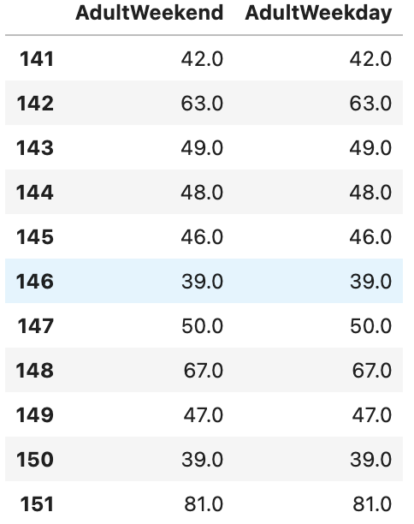
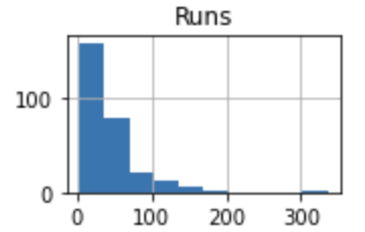
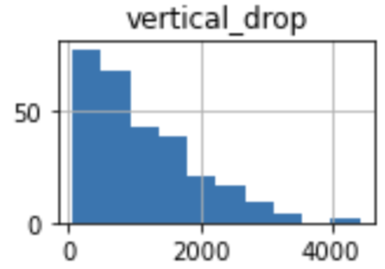
MODELING RESULTS - Data Wrangling
We removed duplicates and rows/columns with missing value - including a column for 8-person lifts and trams
We found valuable information after removing incomplete/unnecessary fields:
Montana resorts charge the same price from Adult weekday and weekend
Average ticket price in Montana is $51.90
There is no relationship between State and Ticket pricing
Big Mountain Resorts 105 trails ranks among the top of all American resorts
BMR’s 2,353ft vertical drop also ranks among the top of all American resorts

Slide 5
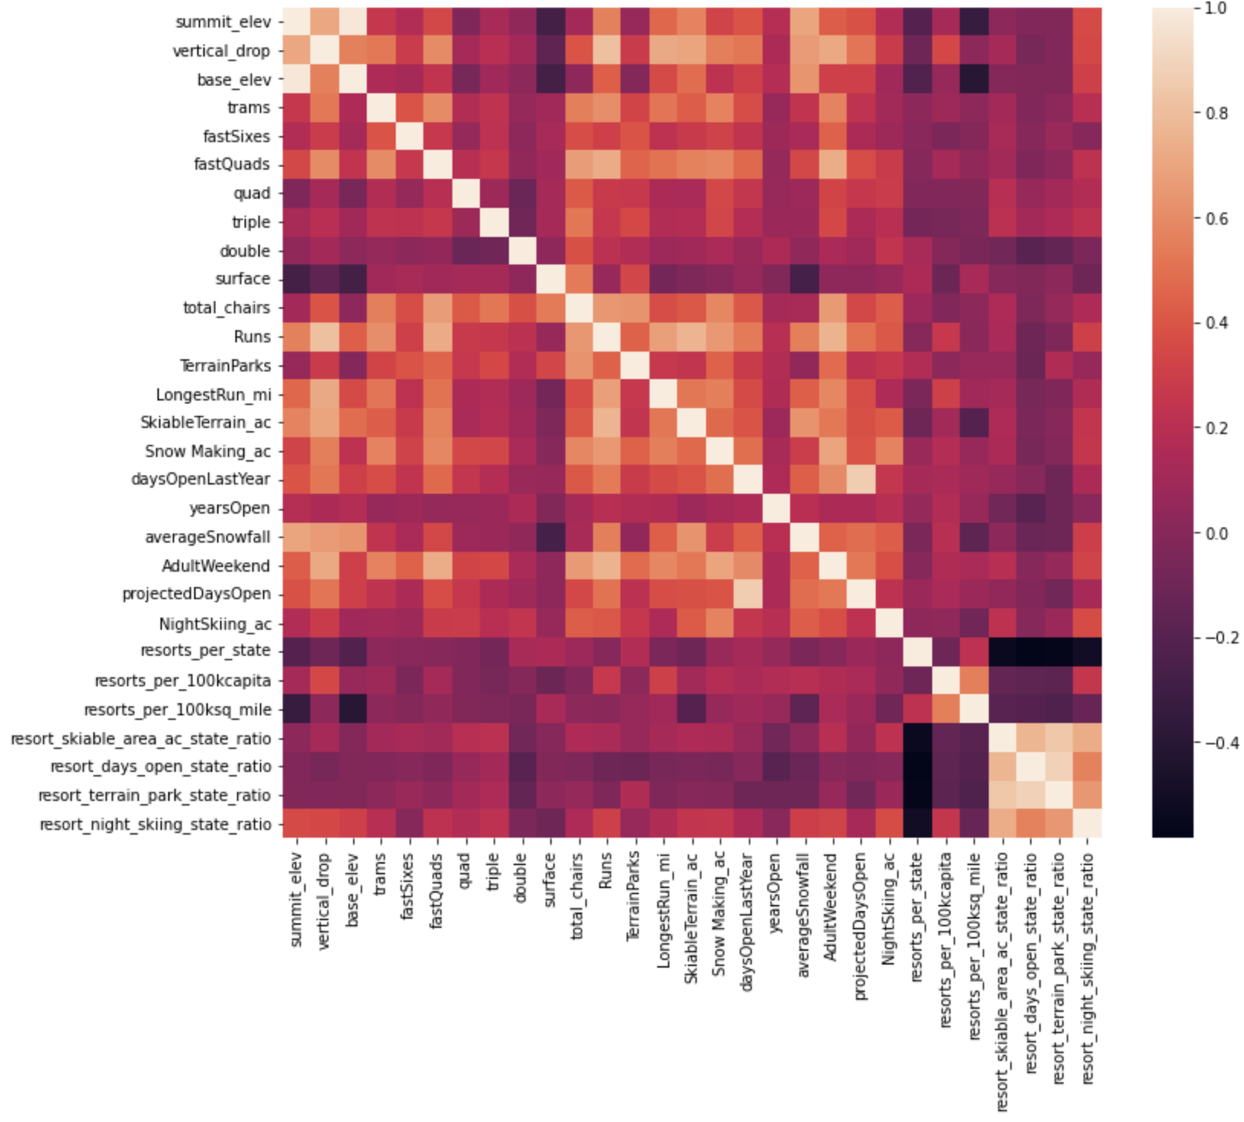
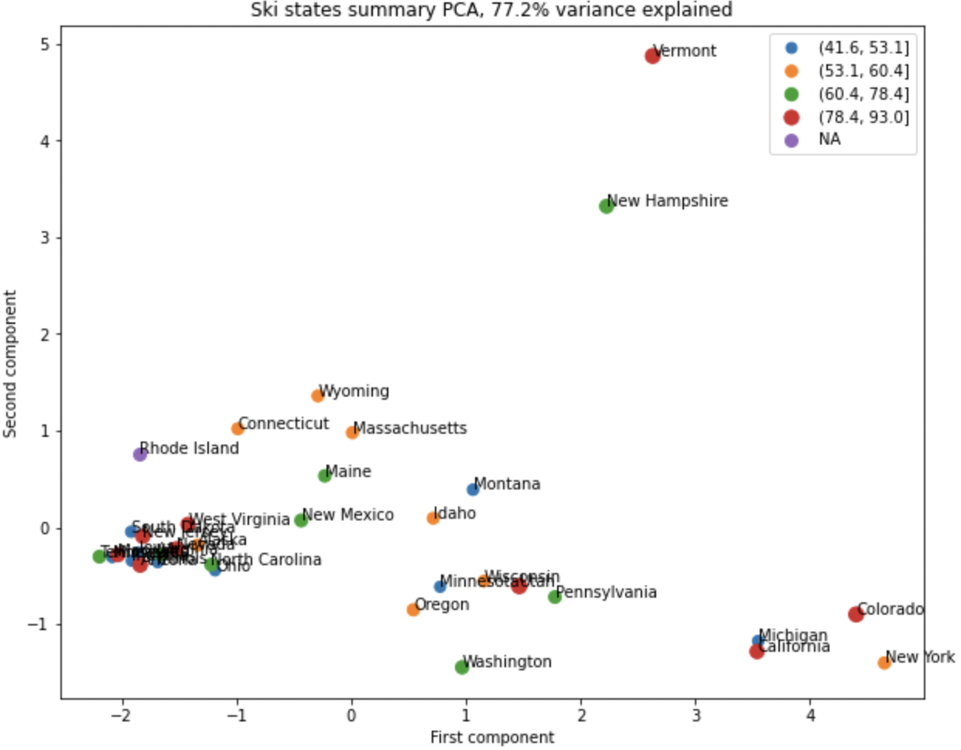
Modeling Results - Exploratory Analysis
We gained valuable insight in this step of the process:
We ran a Principal Component Analysis on the relationship of State and Ticket price
Found that there was no relationship at all
We generated a heat map to find which variables impacted ticket prices
Strong correlation between tix prices and following variables
Fast Quads, Total Runs, Snow Making, and Vertical Drop.
We used the state label to create the 4 fields listed below, to analyze
ratio of resort skiable area to total state skiable area
ratio of resort days open to total state days open
ratio of resort terrain park count to total state terrain park count
ratio of resort night skiing area to total state night skiing area

Slide 6
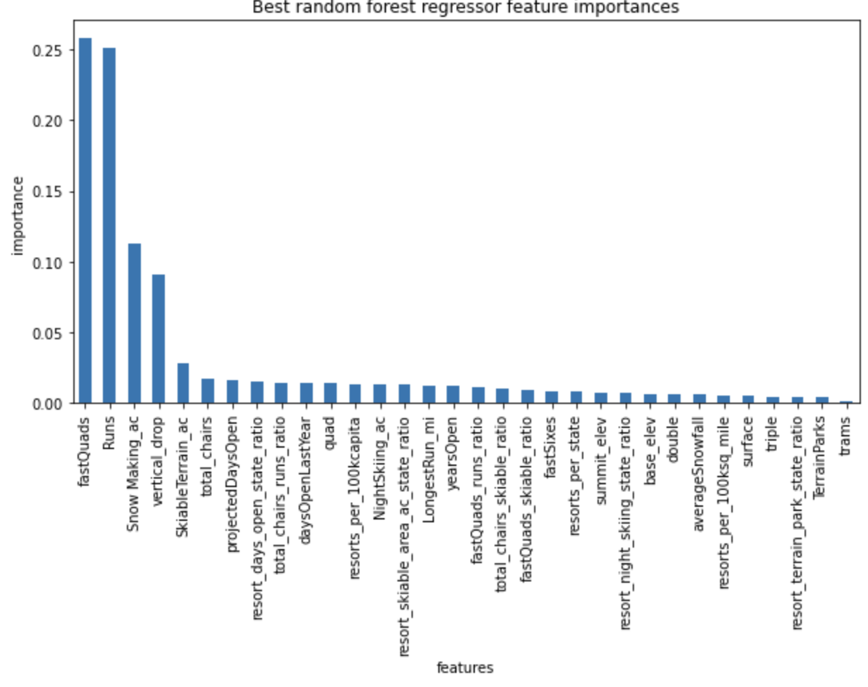
Modeling Results - Preprocessing and Training
We split the data into 2 subsets, 1 subset containing 80% of the data (training set) and another containing 20% of data (testing set)
We used several models to find relationships in the training set, this includes linear regression and Random Forest Model
Pictured below are the top variables that affect ticket pricing according to the Random Forest Model, which we have decided to use
Top 4 Features:
Fast Quags
Total Runs
Snowmaking area covered
Total Vertical Drop

Slide 7
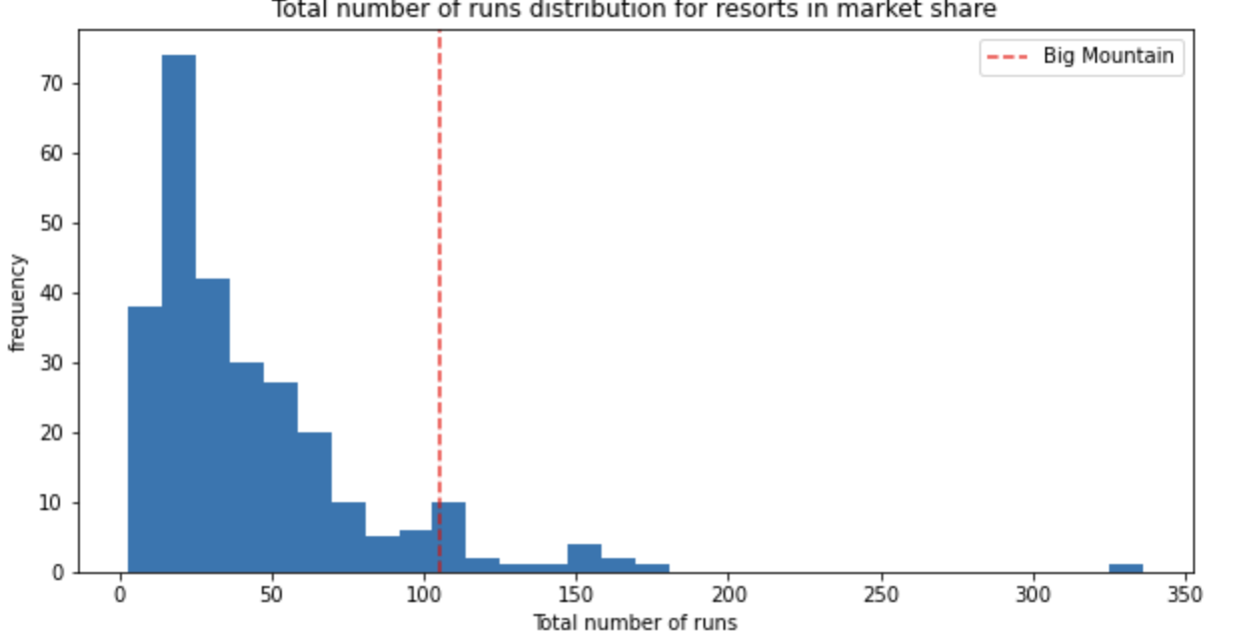
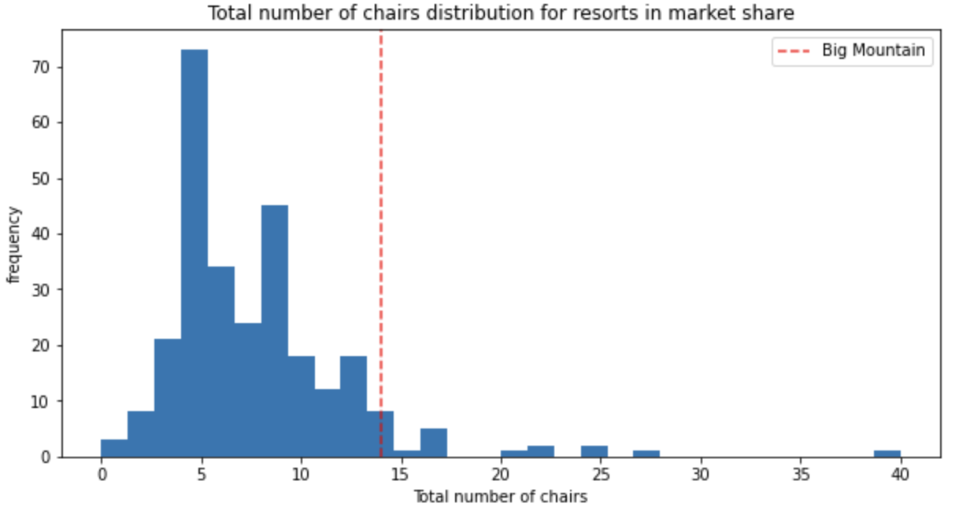
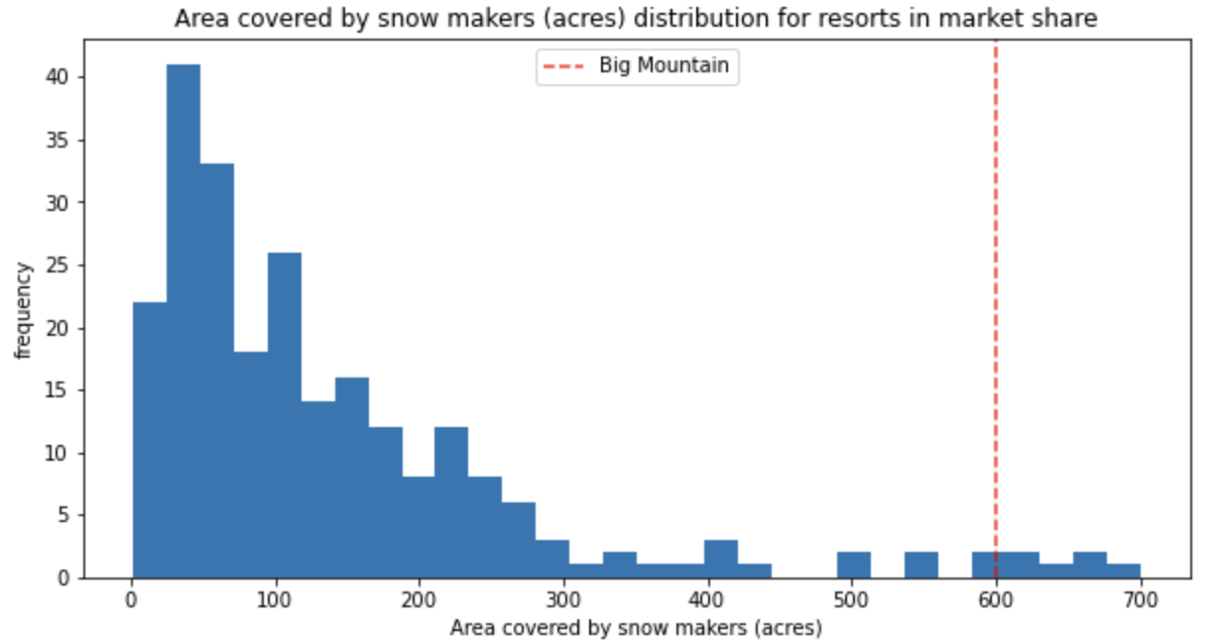
Modeling Results - Conclusion
Big Mountain Resort charges $81 per ticket
According to our model, we can charge upwards of $95.87 per ticket
With an error of $10.39, that is still $4+ more than we are currently charging
We are at the top end of distribution for all the important features mentioned in the slide before
After further analyzing 4 different scenarios to help increase revenue, the best would be
Increase the vertical drop by adding a run to a point 150 feet lower down but requiring the installation of an additional chair lift to bring skiers back up, without additional snow making coverage

Slide 8
Summary
The Data Science team did a ton of work to build out a successful model for Big Mountain Resort
We now have a goal in mind:
Increase the vertical drop by adding a run to a point 150 feet lower down but requiring the installation of an additional chair lift to bring skiers back up, without additional snow making coverage
Before proceeding with this plan, the DS team needs to get a hold of costs for each improvement at the resort before confirming that it is a viable step
This is a giant leap in the right direction towards improving Big Mountain Resort’s revenue but it is not the final step

